Slide 1
Recap
SRF, DDSRF, DSOGI, MCCF, Discrete SRF
SRF: conventional PLL – tracks changes in frequency and phase
DDSRF: attacks the issue of unbalanced grid
DSOGI, MCCF: deal with harmonics and unbalanced grid
The above algorithms were studied from literature, mathematically analyzed and implemented using MATLAB Simulink
Algorithms
SRF – Stationary to synchronous reference frame
Loop Filter, Integrator, Closed loop system
DDSRF – Decoupling network is the major improvement
Enables tracking in unbalanced situation through decoupling of positive and negative sequence voltages
DSOGI – Second order generalized integrator type filter
Filters out the fundamental component in the stationary reference frame
MCCF – Multiple Complex Coefficient Filters
Requires two modules for eliminating every harmonic component
Discrete SRF – Discretized version of the SRF PLL
Input is sampled, transfer functions in z-domain

Slide 2
Formulating a common convention
All existing PLLs are modifications of the conventional SRF PLL
Different conventions are followed in literature
Single platform between different schemes requires a common convention
Simulation of each scheme required an in-depth understanding since mathematical models had to be re-designed to suit to our convention
Each scheme was modeled and tested individually and these models were clubbed into a single self-consistent model for comparison
Complexity involved – more than 600 comparisons!!
5 PLL schemes
SRF
DDSRF
DSOGI
5 imperfections
Unbalanced Grid
L-G Fault
Harmonics
4 variables
MCCF
Discrete SRF
Harmonics + Unbalanced Grid
Frequency Excursion
Space vector v_d
v_q
Error
Estimated angle

Slide 3
Development of an applet (learning tool)
Parts
Initialization program
Simulink models
Intuitive program to plot
Demo
Importance of the applet
Excellent tool for learning – How?
Easy to use
To find out which scheme tackles a particular issue better
Additions of other schemes (if required) can be easily done
Future work
Design optimization aimed at achieving a faster dynamic performance
Verification of results through practical setup

Slide 4
Thank you

Slide 5
Synchronous Reference Frame PLL (SRF)
Back
Situations:
Frequency Excursion
L-G Fault
Harmonics
Unbalanced Grid
Harmonics + Unbalanced Grid

Slide 6
Other PLL scheme comparisons
Back
Situations:
Frequency Excursion
L-G Fault
Harmonics
Unbalanced Grid
Harmonics + Unbalanced Grid
Discrete PLL
Situations:
Frequency Excursion
L-G Fault
Harmonics
Unbalanced Grid
Harmonics + Unbalanced Grid

Slide 7
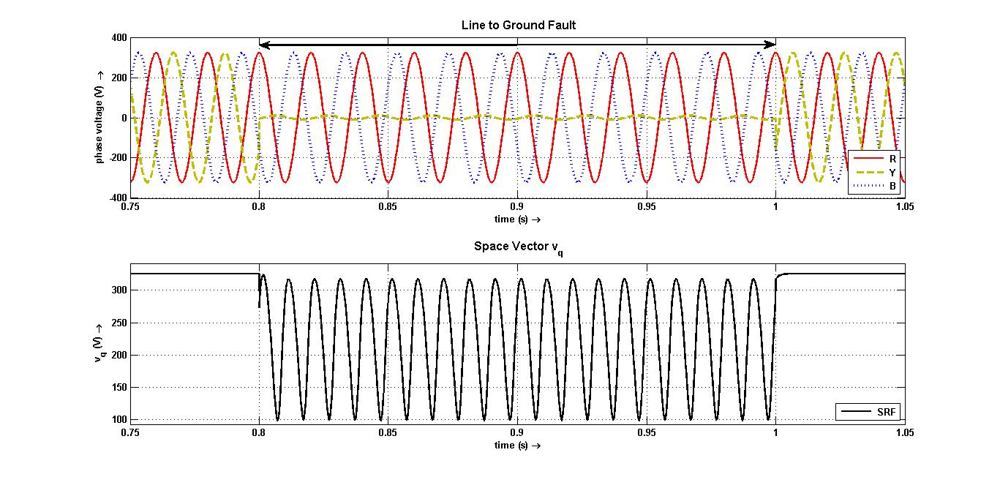
SRF PLL on L-G Fault
Back

Slide 8
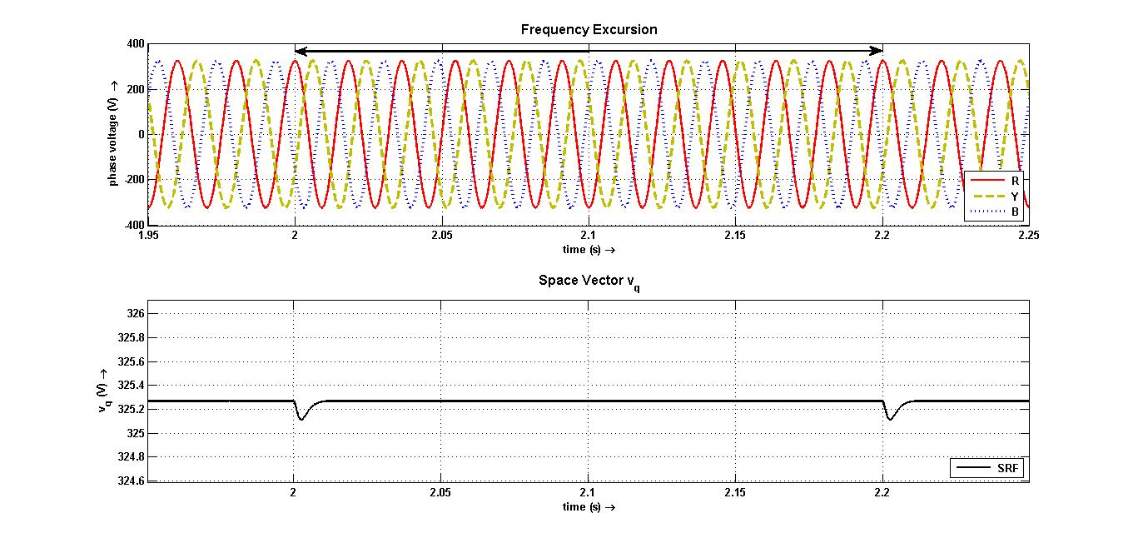
SRF PLL on Frequency Excursion
Back

Slide 9
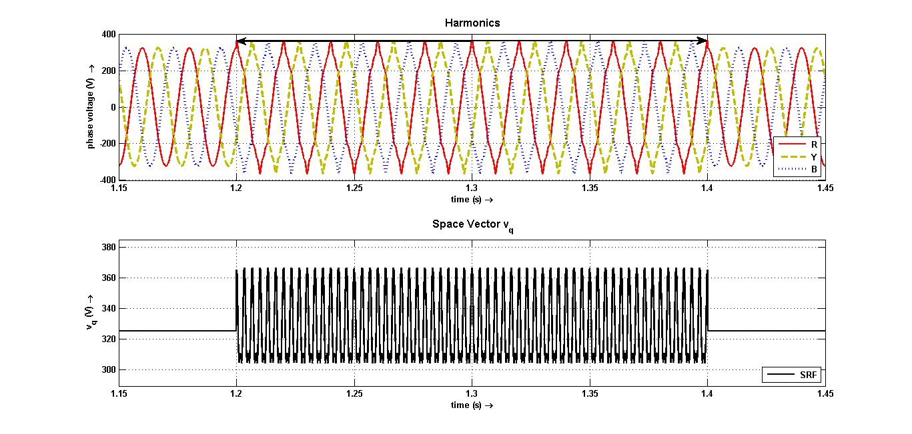
SRF PLL on Harmonics
Back

Slide 10
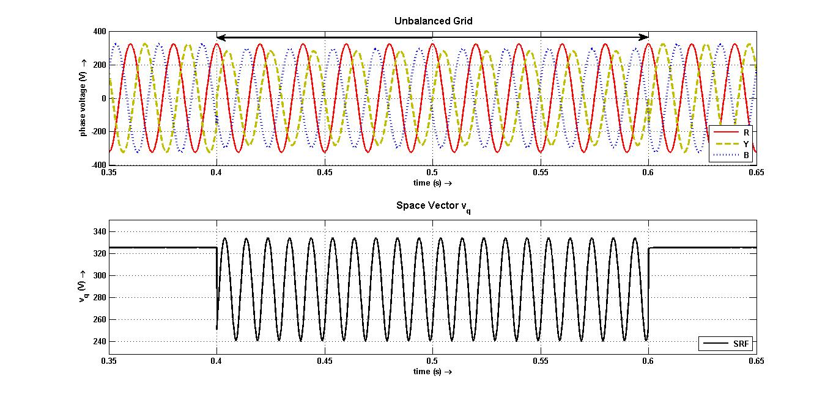
SRF PLL on Unbalanced Grid
Back

Slide 11
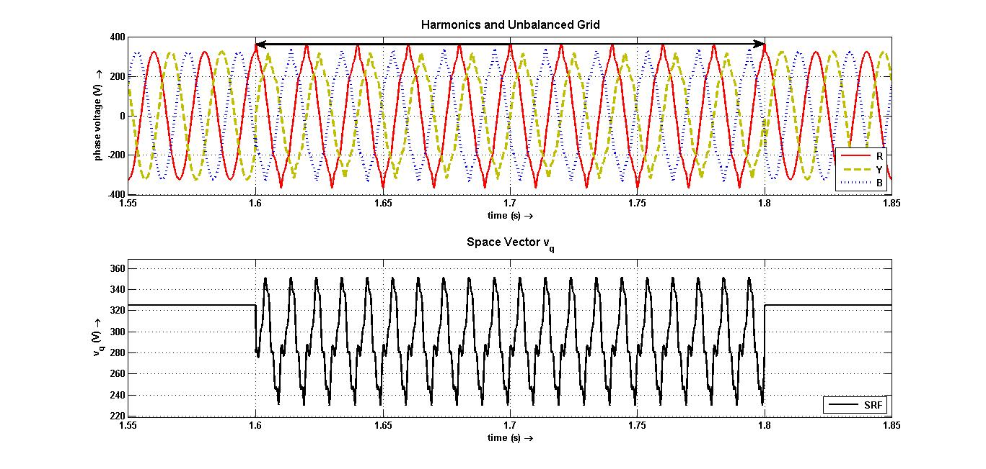
SRF PLL on Harmonics + Unbalanced Grid
Back

Slide 12
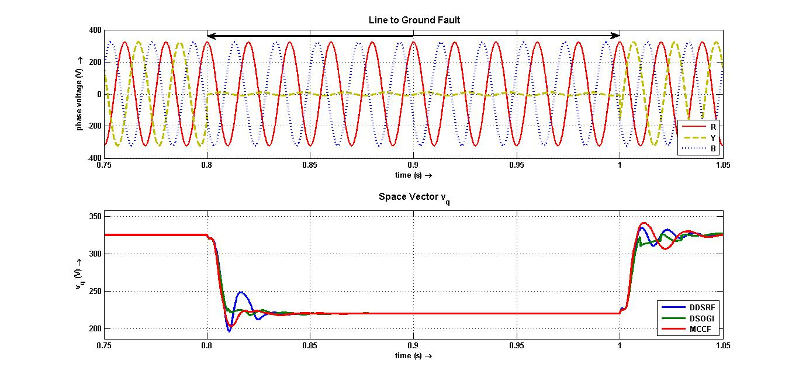
DDSRF, DSOGI, MCCF on L-G Fault
Back

Slide 13
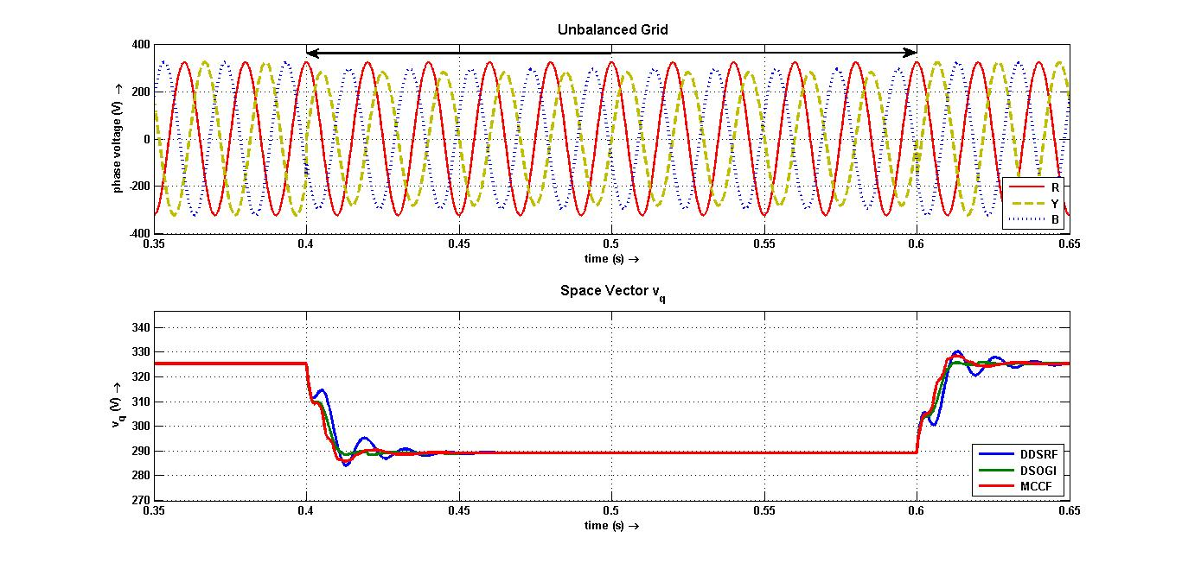
DDSRF, DSOGI, MCCF on Unbalanced Grid
Back

Slide 14
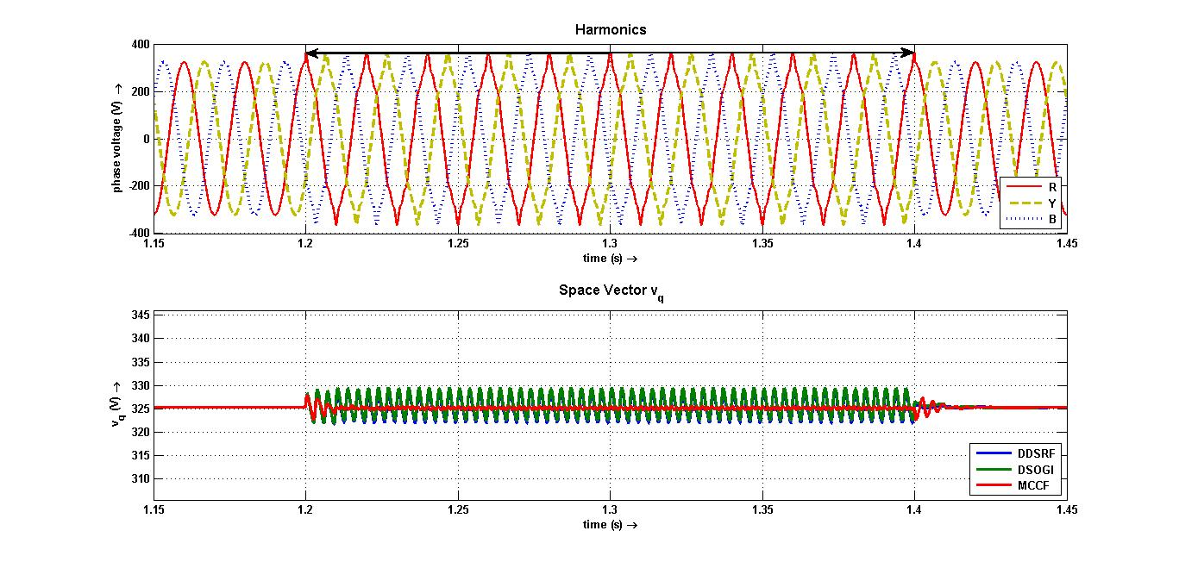
DDSRF, DSOGI, MCCF on Harmonics
Back

Slide 15
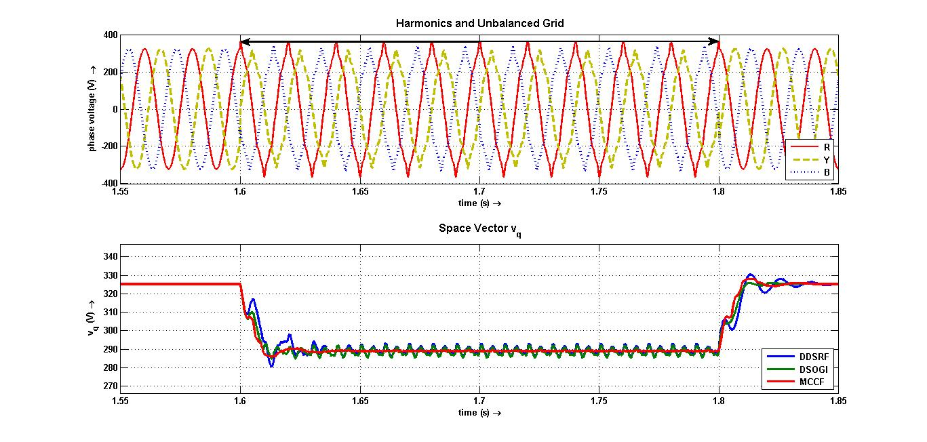
DDSRF, DSOGI, MCCF on Harmonics + Unbalanced Grid
Back

Slide 16
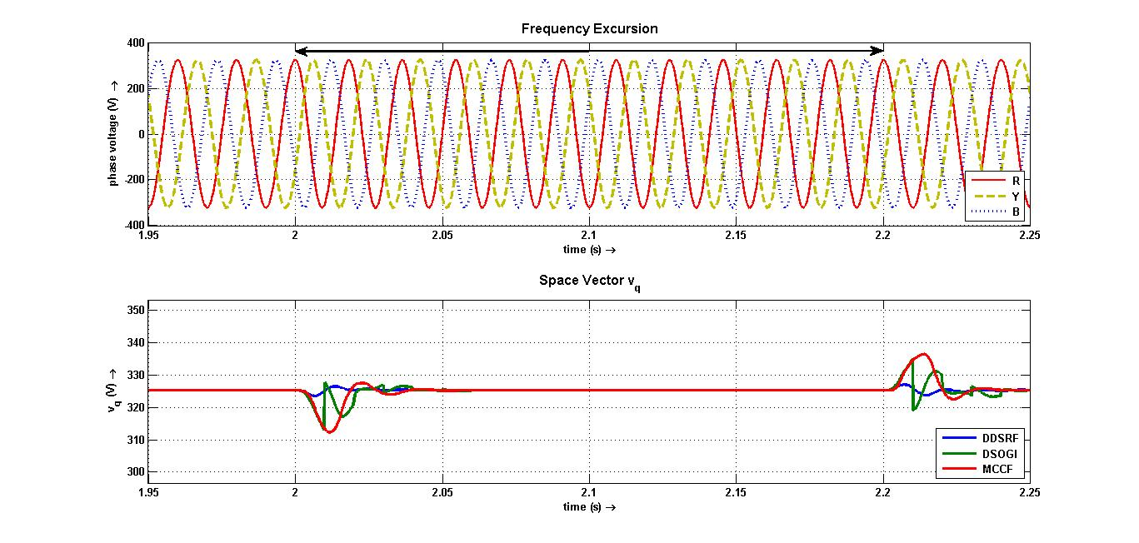
DDSRF, DSOGI, MCCF on Frequency Excursion
Back

Slide 17
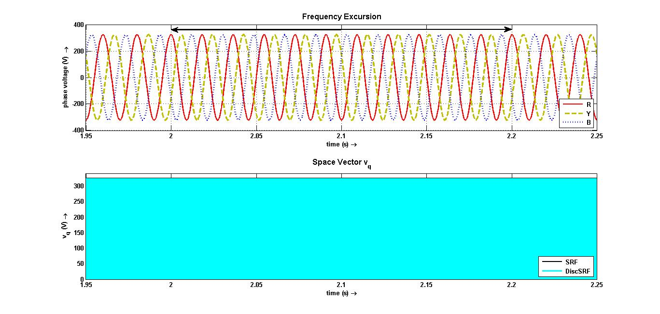
Discrete PLL on Frequency Excursion
Back

Slide 18
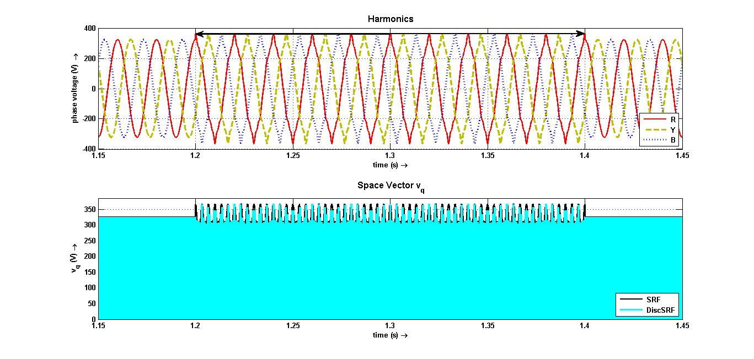
Discrete PLL on Harmonics
Back

Slide 19
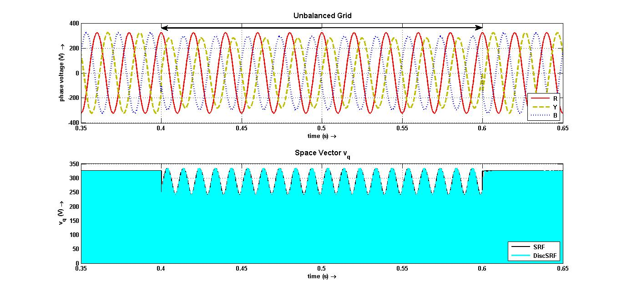
Discrete PLL on Unbalanced Grid
Back

Slide 20
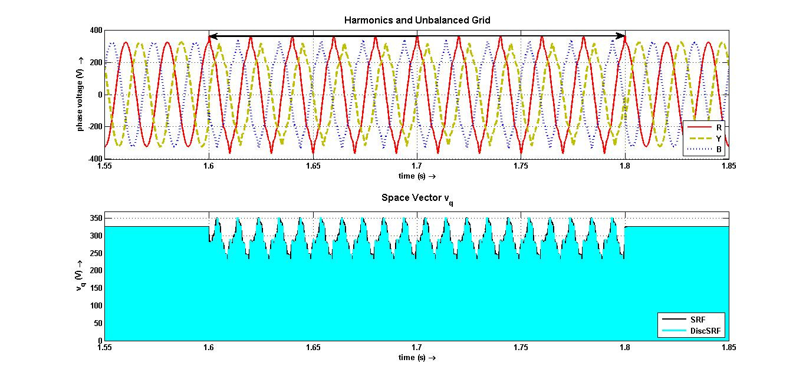
Discrete PLL on Harmonics + Unbalanced Grid
Back

Slide 21
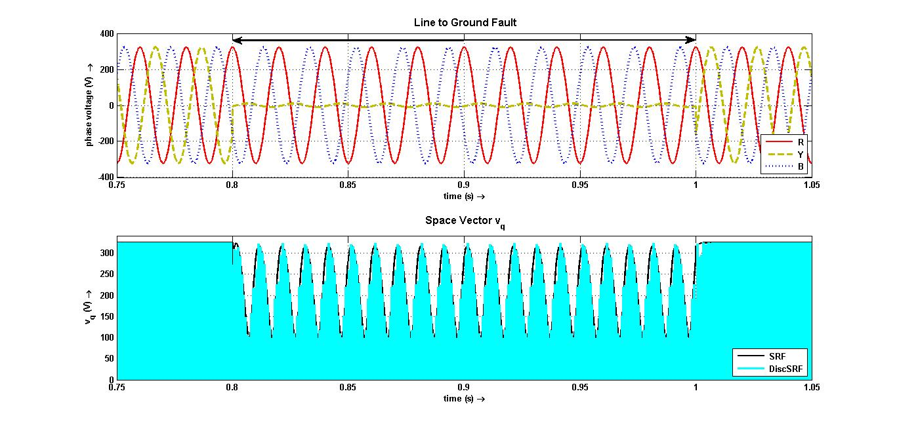
Discrete PLL on L-G Fault
Back

Slide 22
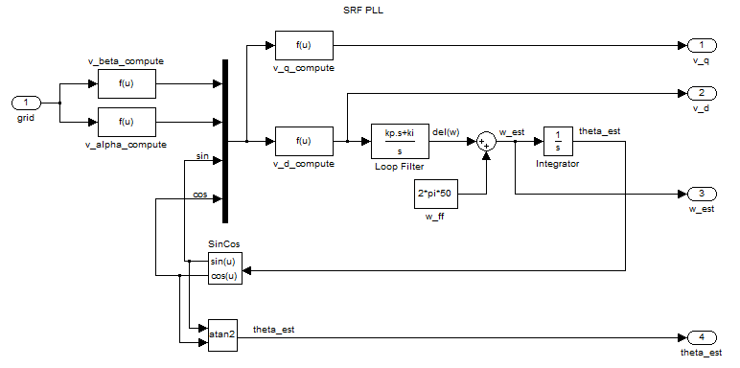
Conventional SRF PLL
Back

Slide 23
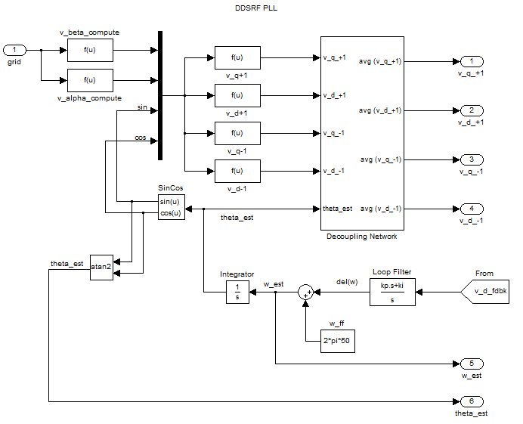
DDSRF PLL
Back

Slide 24
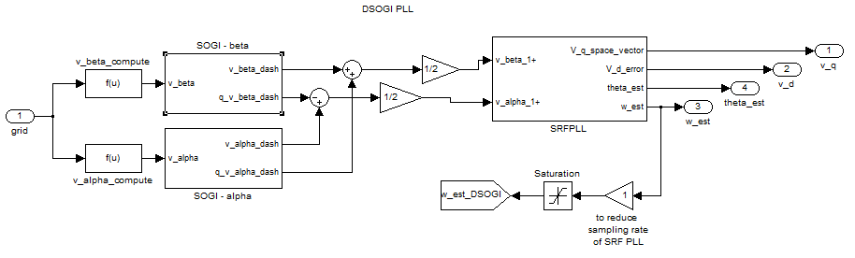
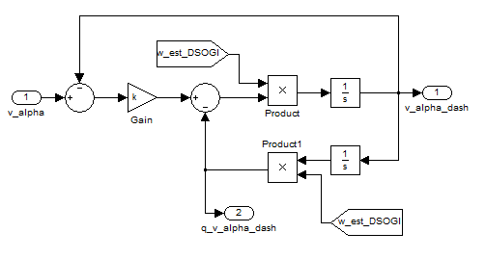
DSOGI PLL
Back

Slide 25
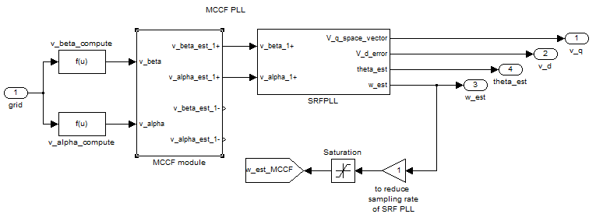
MCCF PLL

Slide 26
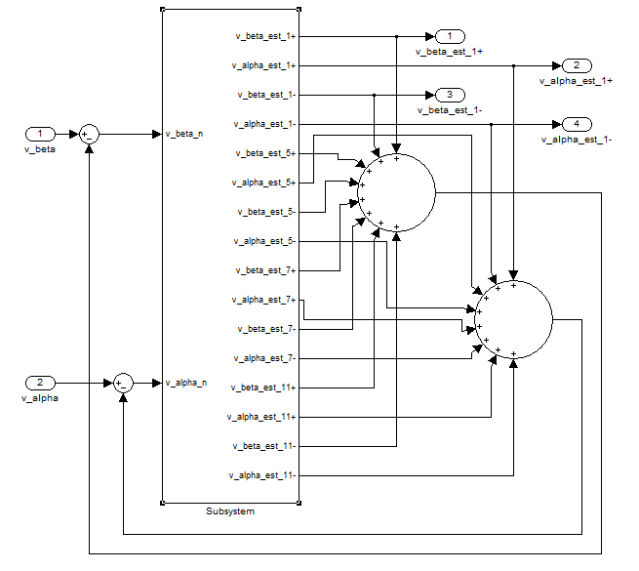
MCCF module (continued)
Back

Slide 27
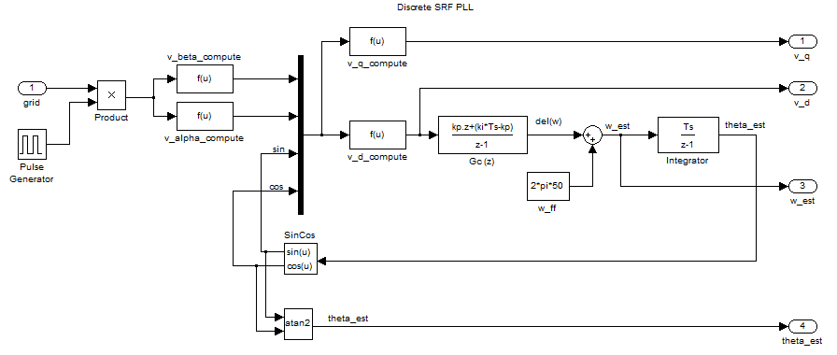
Discrete SRF PLL
Back

Slide 28
Convention followed
Back

Slide 29
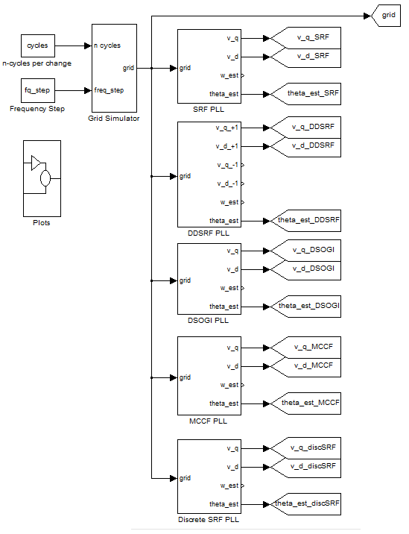
Self-consistent model

Slide 30
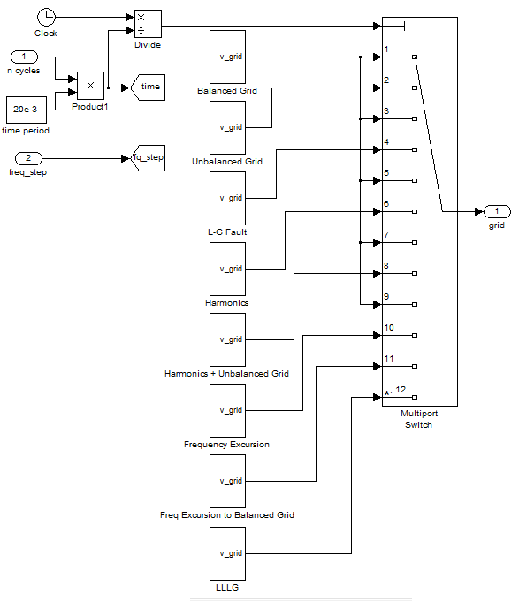
Grid simulator
Back

